Slide 1
Unveiling Trends in Canada's Economic Landscape
Unsupervised Learning using K-MEANS
Submitted By:- Dhruv Parmar (8681628)
Nihal Patel (8945100)
Foundation of Machine Learning (Section 2, Group 3) Guided By:- Ran Feldesh

Slide 2
Objective
The objective of this data analysis is to explore and analyze the trends in the Canadian economy with housing market, economic indicators, and their relationships.
The analysis covers various factors such as housing prices, inflation, affordability, interest rates, and their impact on consumption and savings.
To create clusters that indicates the state of the economy based on the indicators.
To help policy makers and stakeholders to make decisions accordingly
Link to Project - GitHub Code

Slide 3

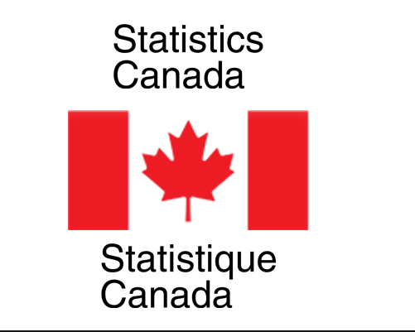
Data Sources:
Housing Index Data:
The dataset provides information on the New Housing Price Index (NHPI) and affordability.
Interest Rates Data:
Key interest rates from the Bank of Canada were scraped from the official website.
GDP Expenditure Data:
Data on GDP expenditure was extracted and transformed for analysis.
Unemployment Rate Data:
Unemployment rate data was obtained and processed for inclusion in the analysis.
Household Saving Rate Data:
Data on household saving rates was collected and formatted for analysis
Current account Surplus (from Statistics Canada):
Data on country’s current account
Consumer Price index (from Statistics Canada))

Slide 4
Data Preprocessing:
Imputation:
Missing values in the NHPI and affordability columns were imputed using the KNN imputation method.
Merging:
Data from different sources were merged based on the year and month columns for a comprehensive analysis.
Scaling:
Min-Max scaling was applied to certain columns to normalize the data.

Slide 5
Analysis:
Exploratory Data Analysis (EDA):
Descriptive statistics and visualizations were used to understand the distribution of key variables.
Correlation Analysis:
A correlation matrix was generated to identify relationships between variables.
Random Forest Regression:
A random forest regression model was applied to assess feature importance.
Clustering:
K-means clustering was used to identify patterns within the data.

Slide 6
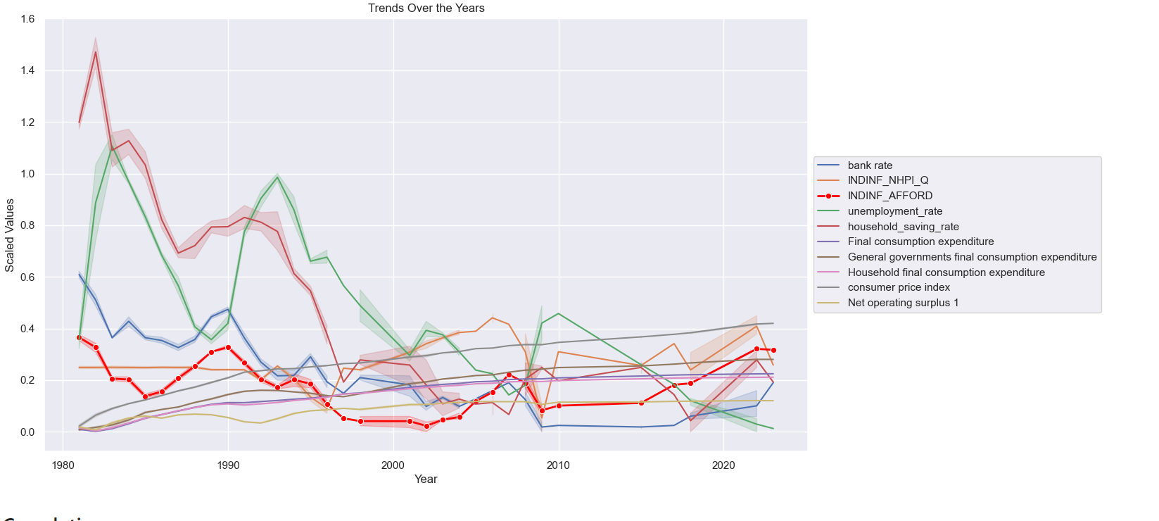
Insights on Data – Yearly Trend

Slide 7
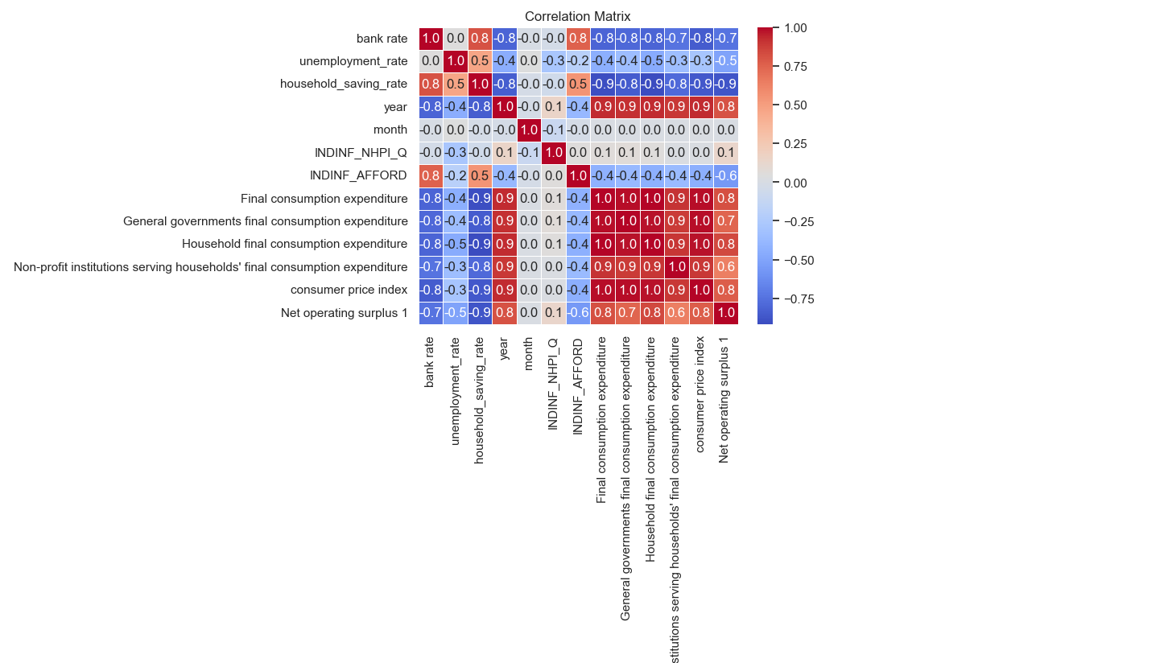
More on Insights

Slide 8
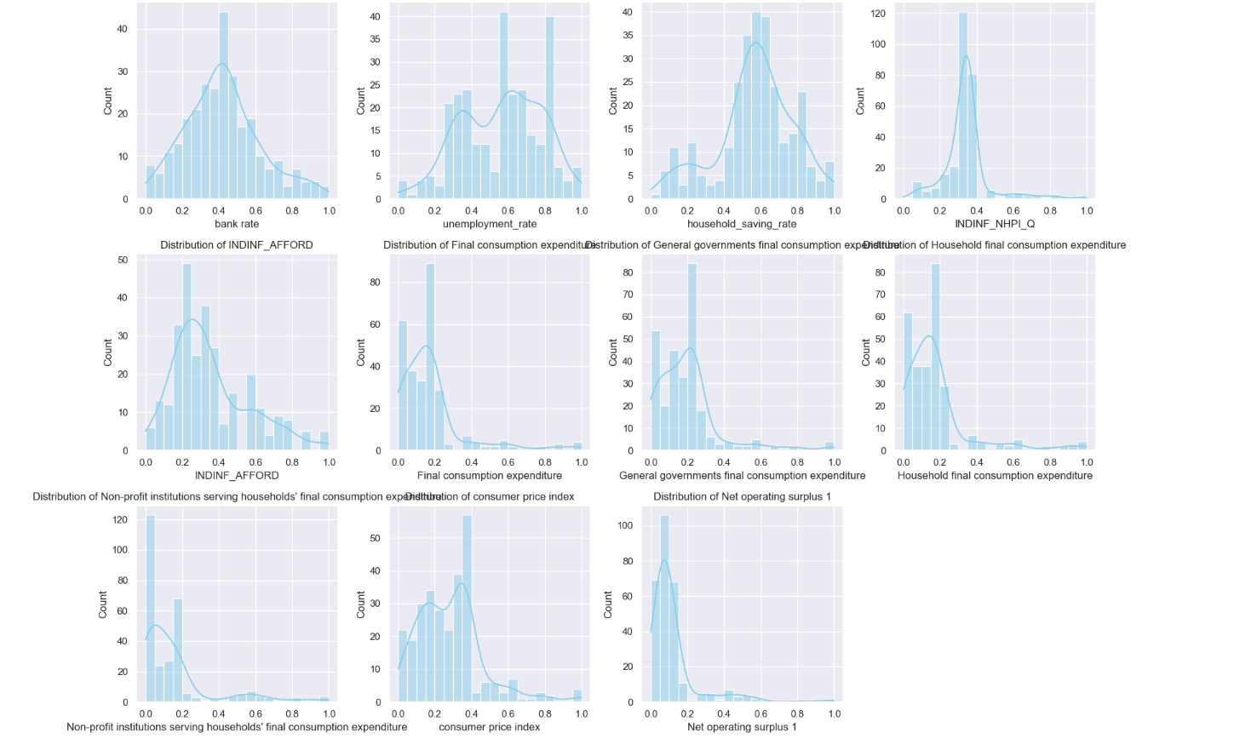
Distribution of Data

Slide 9
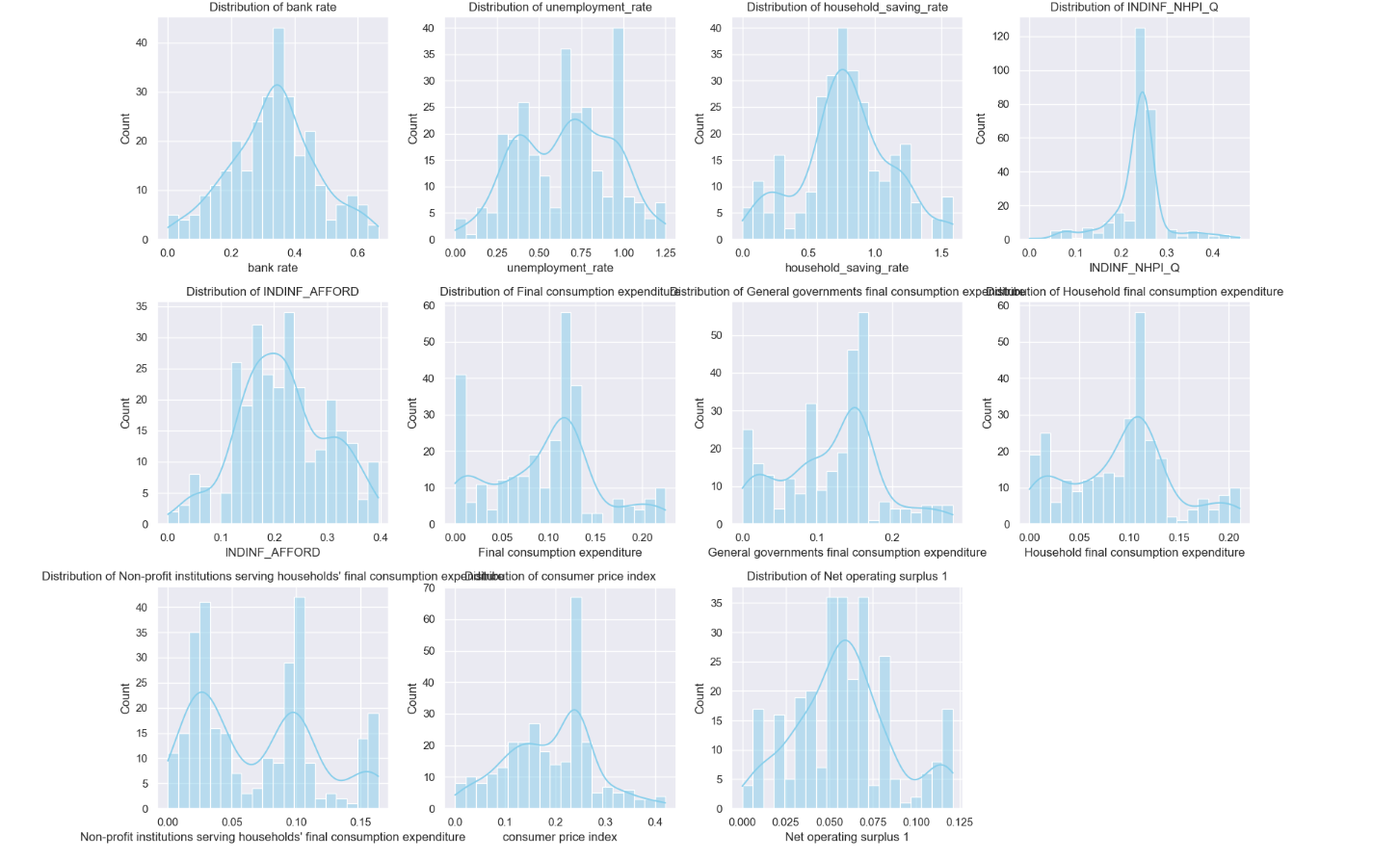
After Handling Skewness with Box cox

Slide 10
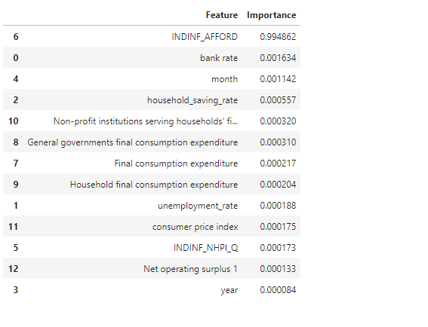
More on Insights – Feature Importance

Slide 11
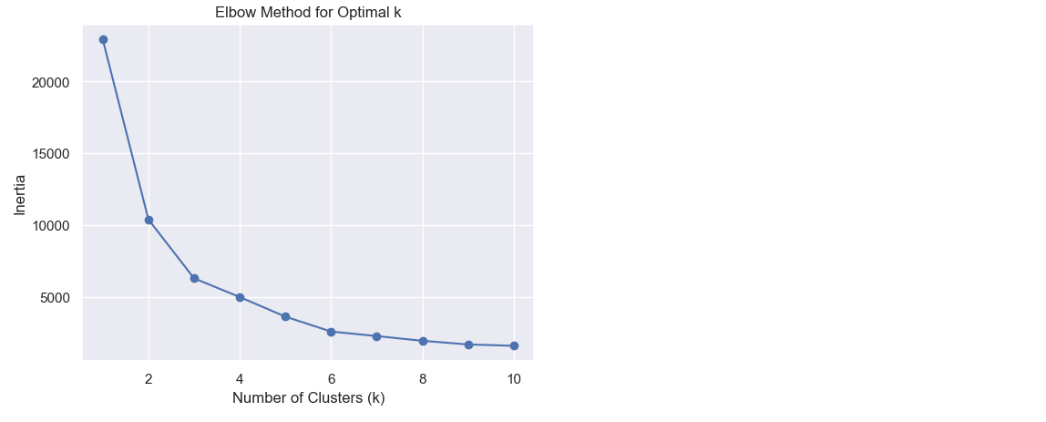
Elbow Method for optimal K

Slide 12
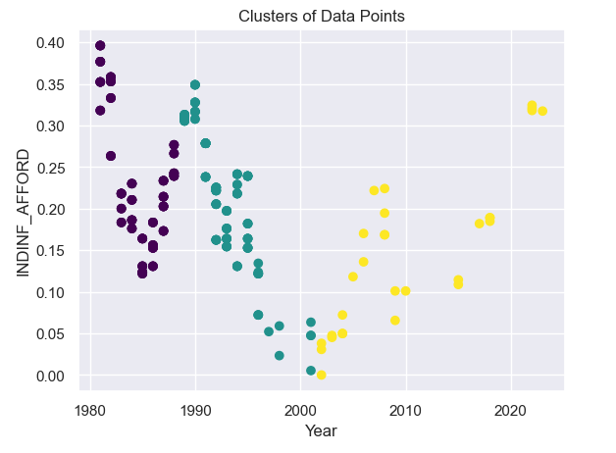
Clusters
silhouette_avg - 0.41461830
Values closer to 1 indicate well-defined clusters.
Values around 0 indicate overlapping clusters or clusters with very close data points.
Values closer to -1 indicate incorrect clustering where data points might be better assigned to a different cluster.

Slide 13
Key Findings after using K-NN
Cluster 1:
Bank Rate: 0.4160
Unemployment Rate: 0.7100
Household Saving Rate: 1.0133
Year: 1984.51
Month: 5.51
INDINF_NHPI_Q: 0.2491
INDINF_AFFORD: 0.2328
Final Consumption Expenditure: 0.0444
General Govt. Final Consumption Expenditure: 0.0589
Household Final Consumption Expenditure: 0.0460
Non-profit Institutions' Final Consumption Expenditure: 0.0246
Consumer Price Index: 0.1097
Net Operating Surplus 1: 0.0452
Cluster 2:
Bank Rate: 0.3041
Unemployment Rate: 0.7025
Household Saving Rate: 0.6865
Year: 1992.78
Month: 5.30
INDINF_NHPI_Q: 0.2092
INDINF_AFFORD: 0.2149
Final Consumption Expenditure: 0.1219
General Govt. Final Consumption Expenditure: 0.1513
Household Final Consumption Expenditure: 0.1164
Non-profit Institutions' Final Consumption Expenditure: 0.0947
Consumer Price Index: 0.2353
Net Operating Surplus 1: 0.0600
Cluster 3:
Bank Rate: 0.0960
Unemployment Rate: 0.2371
Household Saving Rate: 0.1673
Year: 2010.28
Month: 5.24
INDINF_NHPI_Q: 0.3209
INDINF_AFFORD: 0.1466
Final Consumption Expenditure: 0.2034
General Govt. Final Consumption Expenditure: 0.2376
Household Final Consumption Expenditure: 0.1938
Non-profit Institutions' Final Consumption Expenditure: 0.1578
Consumer Price Index: 0.3461
Net Operating Surplus 1: 0.1147

Slide 14
Interpretation
Clusters exhibit distinct patterns in economic indicators, housing characteristics, and time trends.
Cluster characteristics provide valuable insights for targeted analysis and decision-making.

Slide 15
Clusters’ Characteristics
Cluster 1: Contraction
Description: This cluster indicates a period of economic contraction or downturn.
Reasoning: High unemployment rates, elevated bank rates, and a notable increase in the household saving rate suggest economic challenges. Additionally, lower values for final consumption expenditure components and a moderate consumer price index may reflect reduced economic activity and spending.
Cluster 2: Stability
Description: This cluster represents a relatively stable economic period.
Reasoning: Moderate values for bank rate, unemployment rate, and household saving rate suggest a balanced economic environment. The consumer price index is moderate, and there are moderate to high values for final consumption expenditure components, indicating a stable level of economic activity.
Cluster 3: Expansion
Description: This cluster signifies a period of economic expansion or growth.
Reasoning: Low unemployment rates, low bank rates, and a relatively low household saving rate suggest favorable economic conditions. High values for final consumption expenditure components, a high consumer price index, and a high net operating surplus indicate increased economic activity, spending, and overall growth.

Slide 16
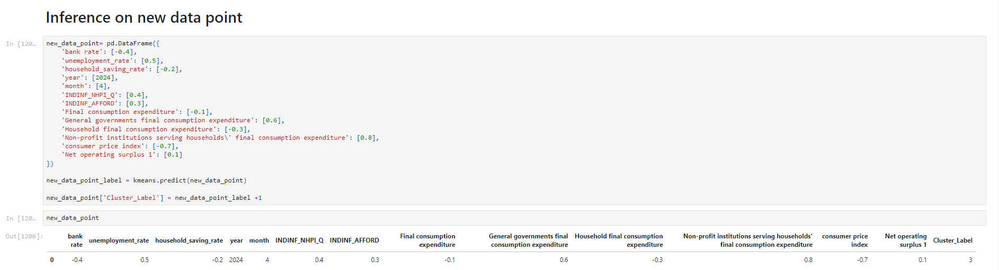
Inference
Cluster 3 – Economy is Expanding

Slide 17
Conclusion
Identified three distinct economic clusters, revealing diverse economic profiles.
Explored housing indices, affordability, and consumption patterns.
Analyzed the impact of interest rates, unemployment, and household savings on housing trends.
Utilized machine learning for predictive modelling of economic clusters.
Provided actionable insights for policymakers, investors, and real estate professionals.
Emphasized the dynamic nature of economic trends, requiring continuous monitoring.
Equipped stakeholders with a nuanced perspective for strategic decision-making.

Slide 18


